Slide 1
Identifying Cultural Food Epicentres
Richard Swain Jr.

Slide 2
Problem Statement
Immigrants to Canada often most are tasked with securing stable employment as part of their agreement with the government. Many are skilled workers and even entrepreneurs looking to re-establish themselves. To the unknowing, this could prove to be a daunting and time intensive task. In this scenario, we consider the potential restaurant owners coming out of the Caribbean.

Slide 3
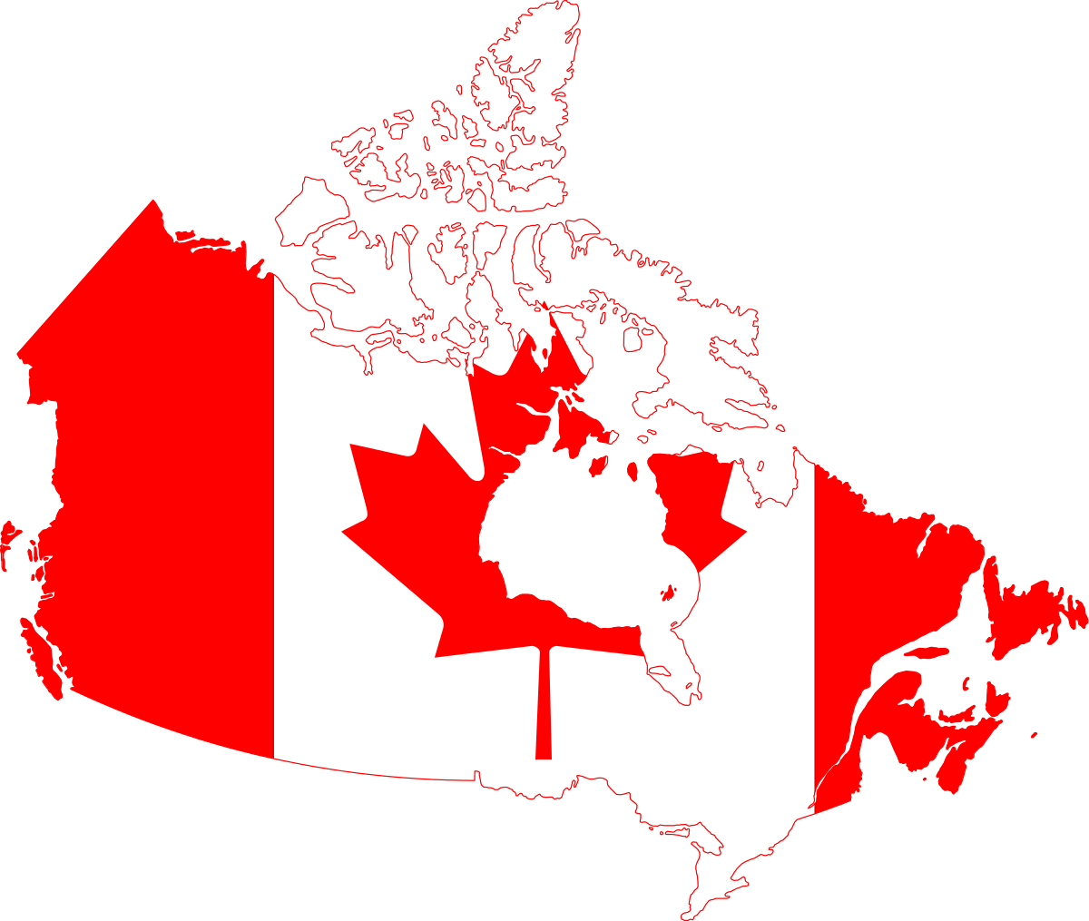
Background information
Toronto has 5 boroughs which have a combined tally of 103 neighbourhoods.
In 2019, the province of Ontario (of which Toronto is the capital) saw an increase of 139,071 legal immigrants out of a total of ~313,000[1].
Migrants from the Americas account for roughly 15% of the 313k immigrants.
Canada has become a vast multicultural society with over 250 ethnic groups reported in 2016.

Slide 4
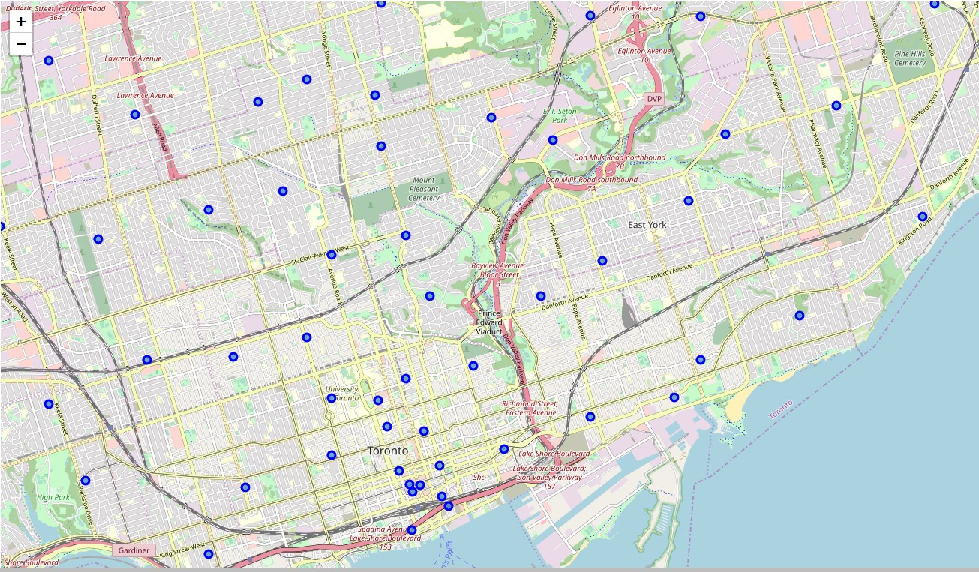
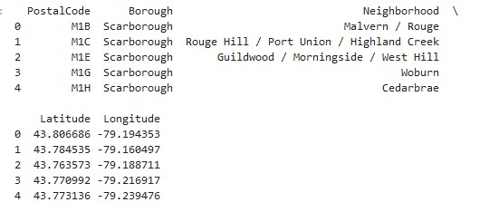
Data Acquisition
Toronto Borough information was scrapped from the Wikipedia webpage.
The data was cleaned up and filtered to show geographical information.
Foursquare API pulled venue information for the neighbourhoods.
Map of Toronto’s Boroughs & Neighbourhoods

Slide 5
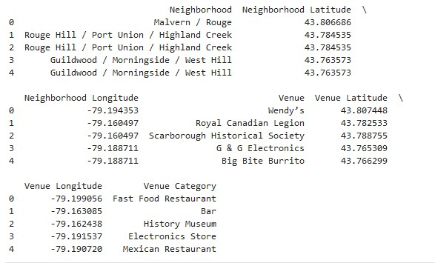
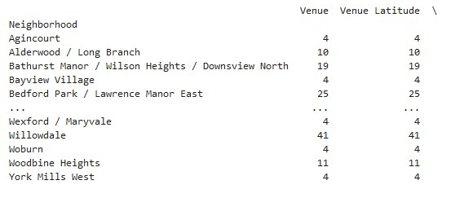
Data breakdown
Venue Count per Neighbourhood
Venues in Neighbourhoods

Slide 6
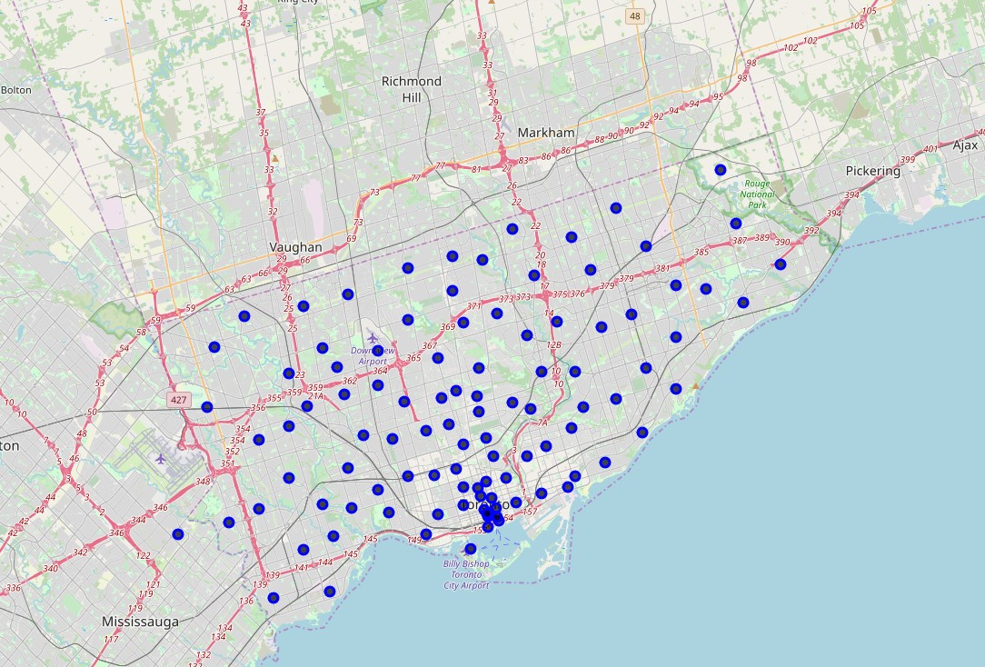
discussion
Observations
Recommendations
Asian themed restaurants are more common throughout the Boroughs.
Fast Food restaurants and take-aways are also very common
Cultural food centres such as Chinatown and Lil Jamaica (only Caribbean presence) are present and gives context for the expected demographic to that area.
Any neighbourhood is a good candidate for a Caribbean themed restaurant.

Slide 7
conclusion
Fair to say that there are ample opportunities for immigrants to find ideal locations for food-based businesses in most if not all areas of Toronto. This model can be utilized to explore the market presence of any other business type.

Slide 8
references
“Number of immigrants in Canada from 2000 to 2019 (in 1,000s).” Statista. Web. https://www.statista.com/statistics/443063/number-of-immigrants-in-canada/
Foursquare API
Wikipedia – Toronto Postal Codes

